Slide 1
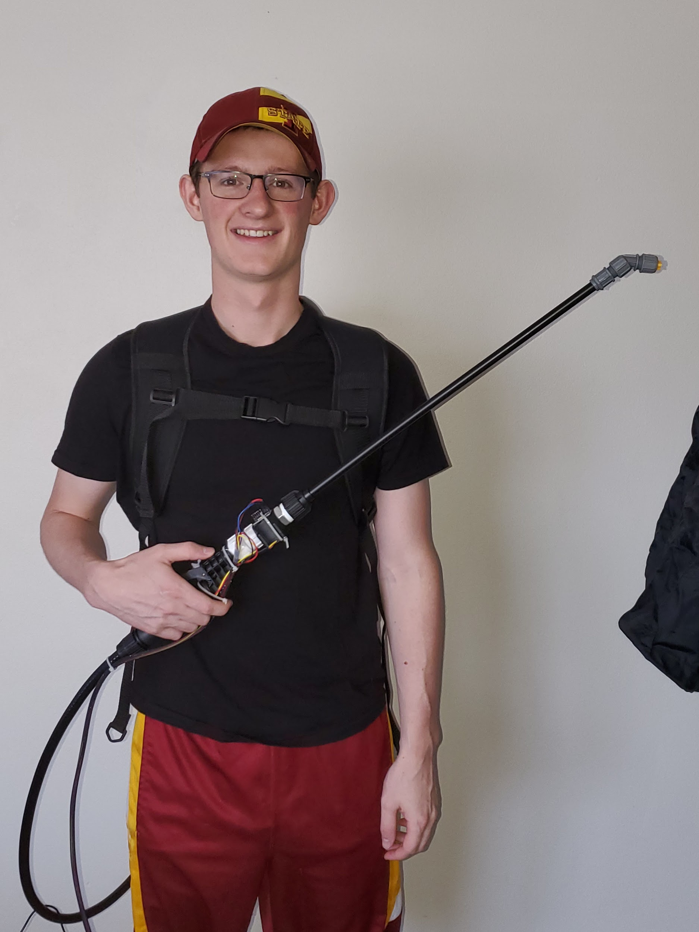
SDMAY20-53:
Smart Backpack Sprayer
David Hayes (Communication Engineer)
Madison Kriege (Communication Engineer)
Kevin Davis (Hardware Research Engineer)
Sean Doran (Logistics Engineer)
Donald Laracuente (API Research Engineer)
Shuangquan Li (iOS Engineer)
Client: IntelliSpray
Advisor: Dr. Daji Qiao
http://sdmay20-53.sd.ece.iastate.edu/
Notes:
David

Slide 2
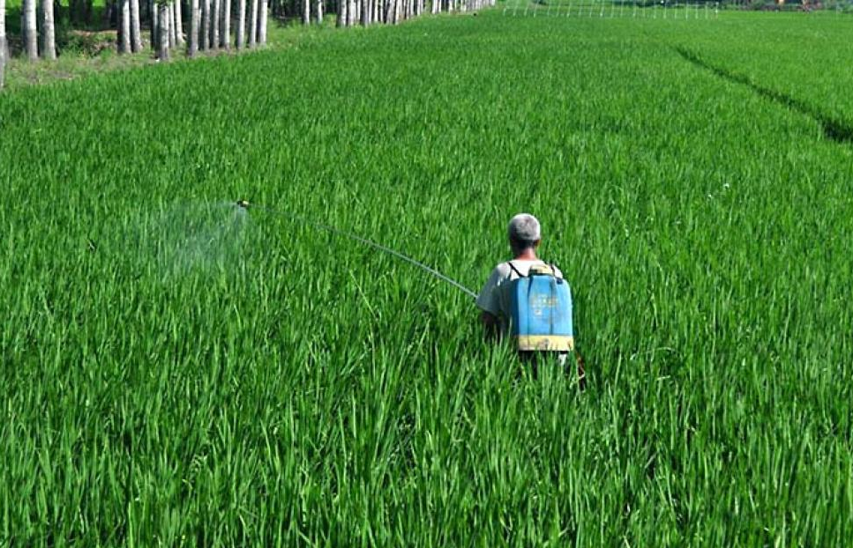
Problem Statement
Problem:
Tracking when and where a user has sprayed is hard
User could forget where they have sprayed and spray areas twice or never
Solution:
Collect data from a backpack sprayer on a phone
Store the data for the user to reference to ensure the best coverage
David
Notes:
David

Slide 3
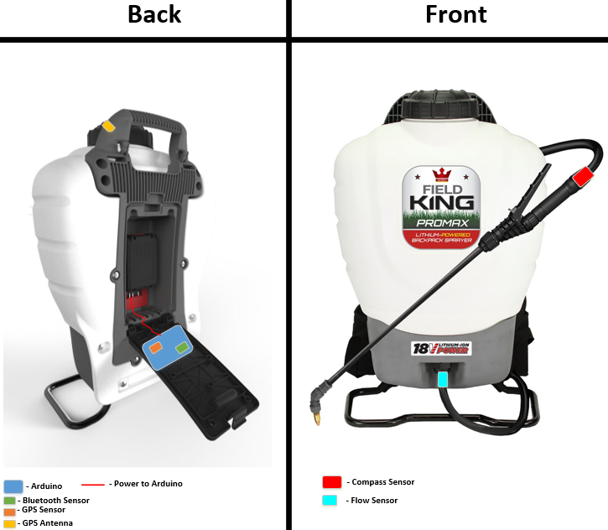
Functional Requirements
The hardware shall
Use a GPS sensor with accuracy to 3 meters
Have a battery life at least 3 hours
Be mountable inside backpack sprayer
Package data in JSON format
Be able to send data using Bluetooth LE
Data shall be collected in 1 second intervals
The app shall
Display data in the map with a pin
Sync data between cloud and local
Display the data to the user
Support multiple users (login feature)
Kevin
Notes:
Kevin

Slide 4
Non-Functional Requirements
The system shall
Be water resistant
Be operable in temperatures between 0-40C
Be under 50 pounds
Be wearable on one’s back
The app shall
Only allow authorized access to the data
Support large amounts of data transmission
Madison

Slide 5
Technical and Other Constraints
Mobile platform - iOS
Data format - JSON
Close range communication - Bluetooth LE
Low/off network connectability
Madison

Slide 6
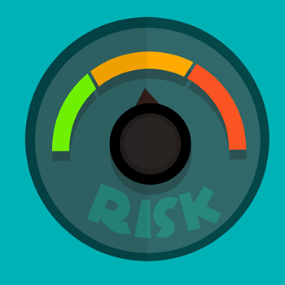
Challenges, Risks, and Mitigation
Issues
Size constraints
iOS backwards compatibility with iOS 13
Soldering
Solutions
Using a smaller Arduino
It is not backwards compatible / Roll Back to 12
More practice
Donald
Notes:
Donald

Slide 7
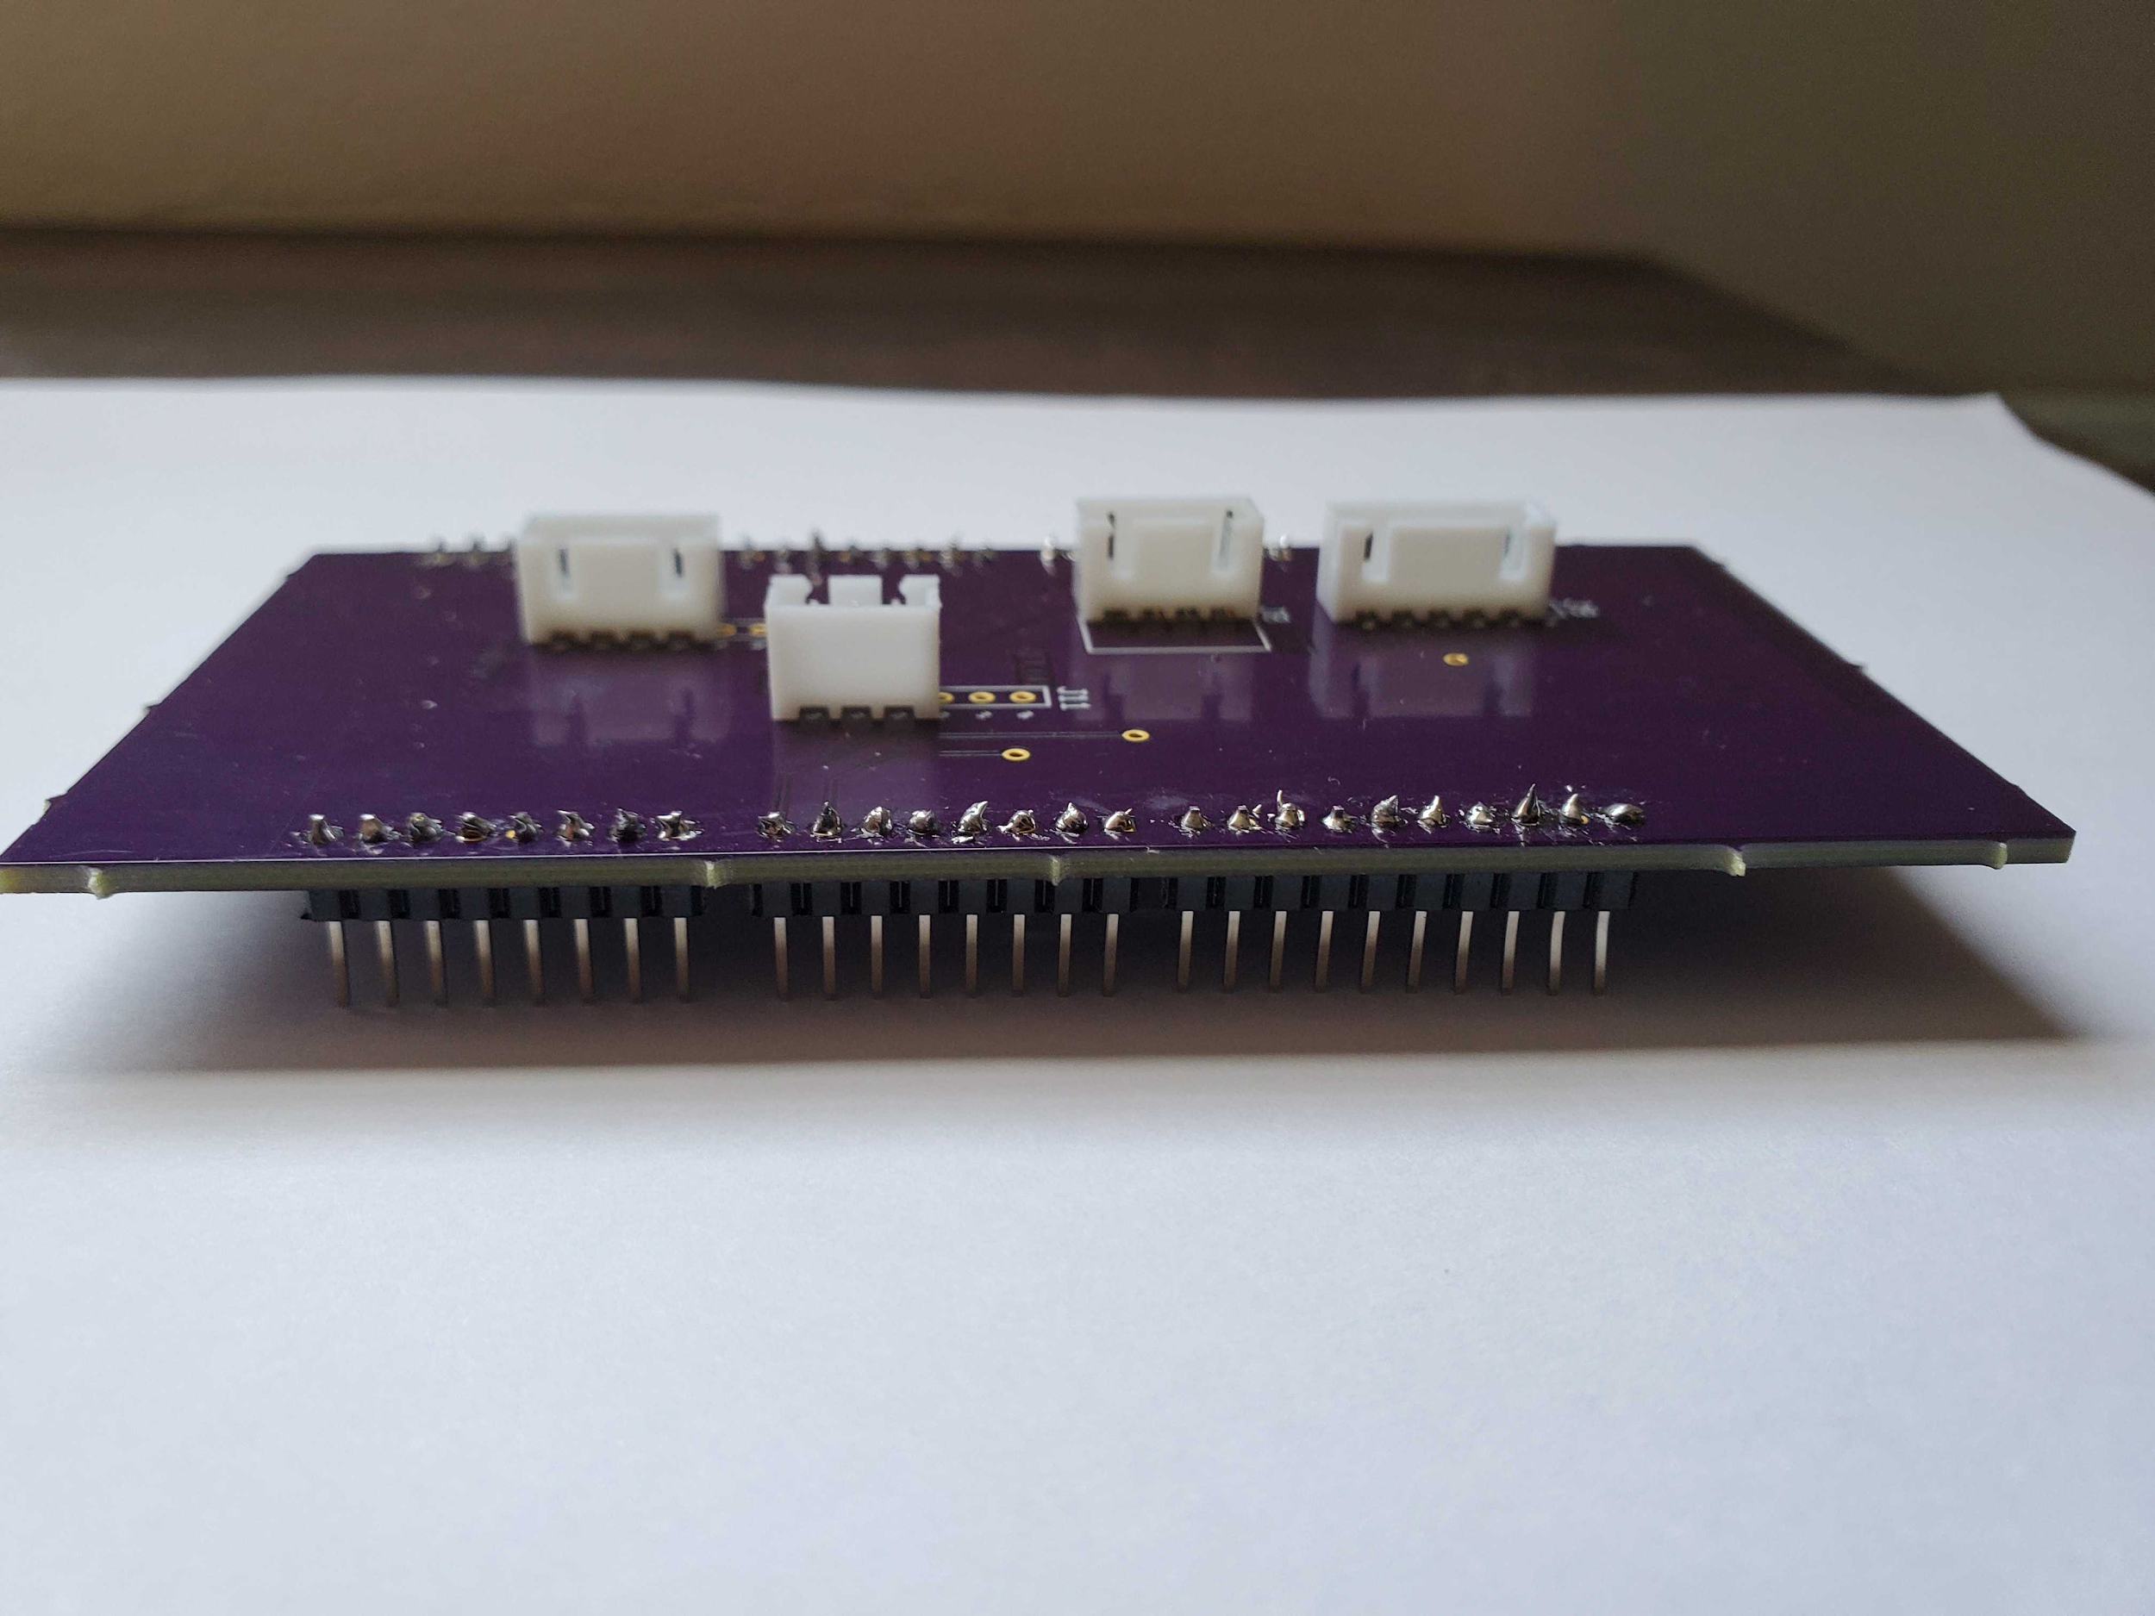
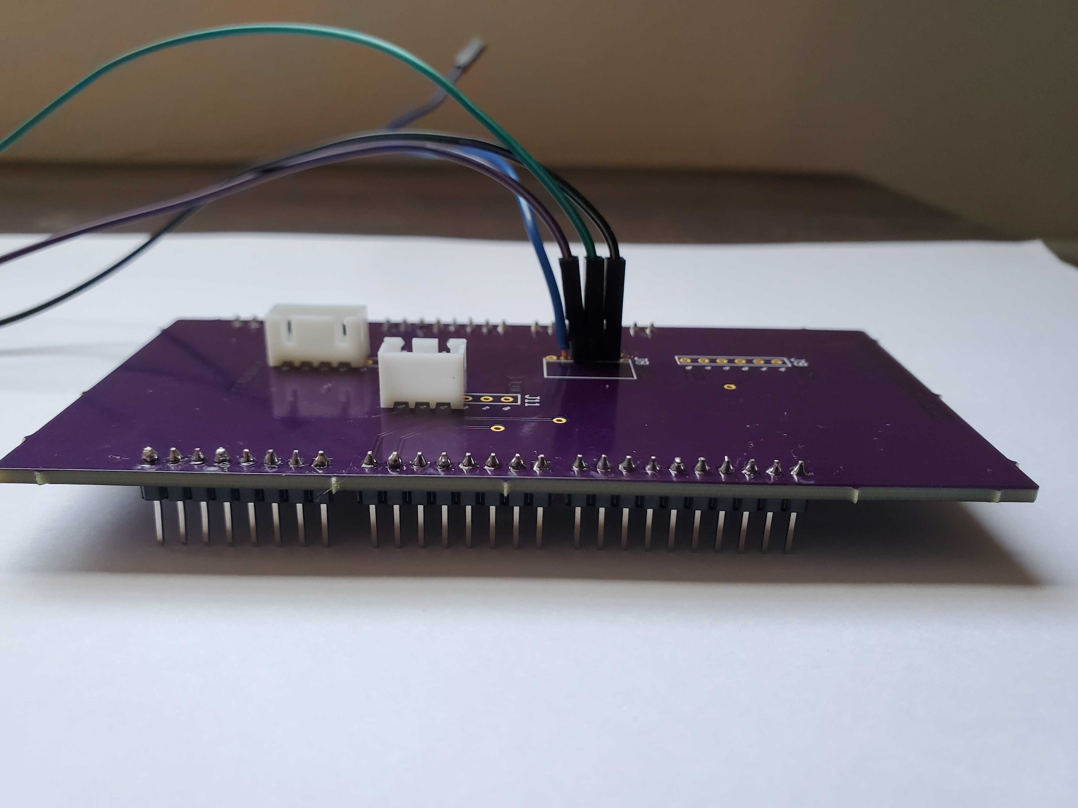
First Attempt
Second Attempt
Sean

Slide 8
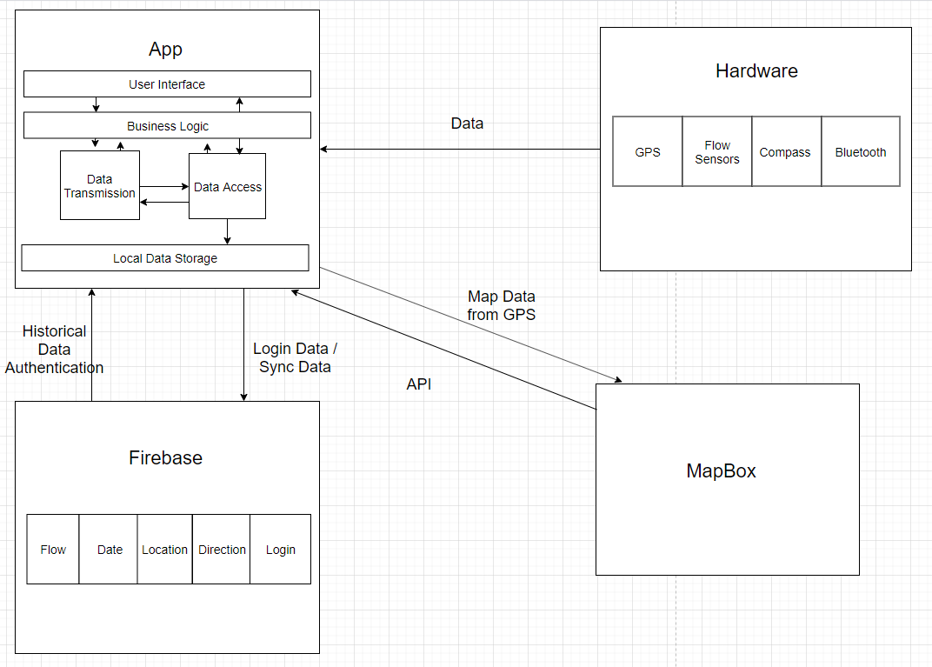
System Architecture Diagram
Shuangquan

Slide 9
Detailed Design - iOS Application
Emphasis on user interface, system, and container/modular design
Data Persistence
Receive data from hardware device
Store/cache data in local database
Sync to cloud at the same time
After passing the threshold, send data to cloud, and release local storage
Technologies Used
SwiftUI, UIKit
CoreData, CoreBluetooth, CoreLocation
Firebase, Mapbox
Shuangquan
Notes:
Shuangquan

Slide 10
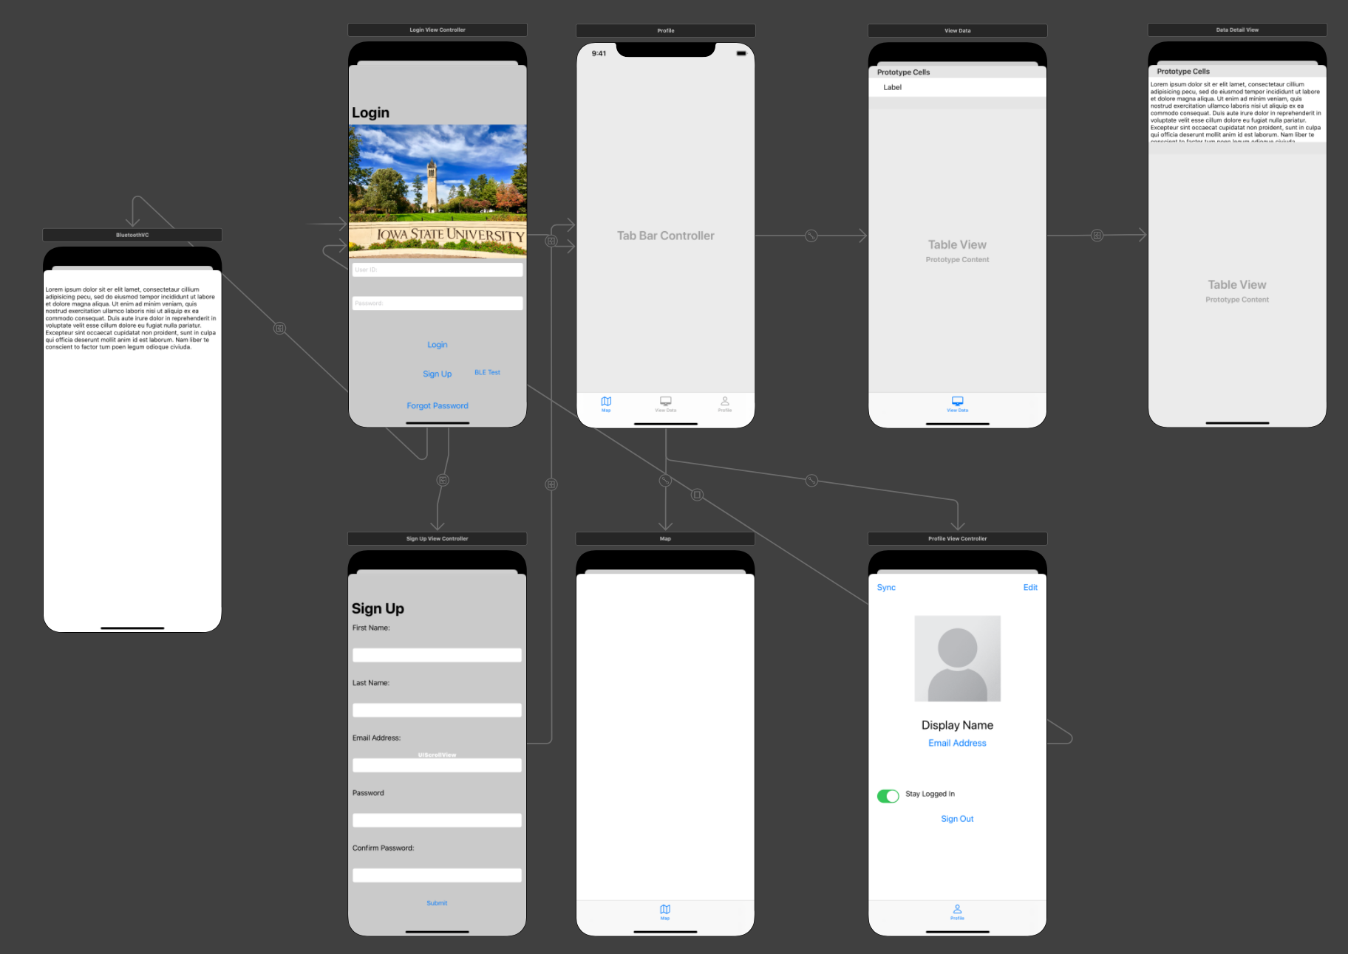
Detailed Design Interface Diagram
Shuangquan
Notes:
Shuangquan

Slide 11
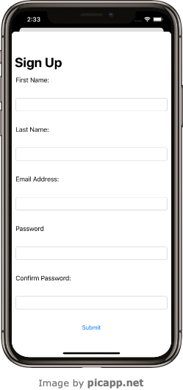
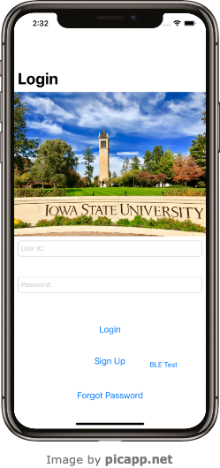
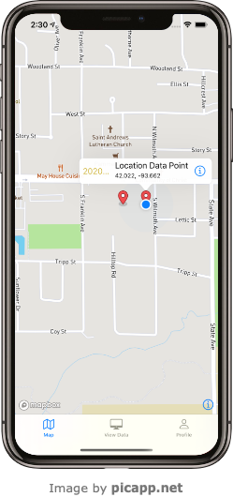
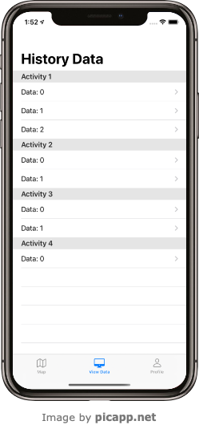
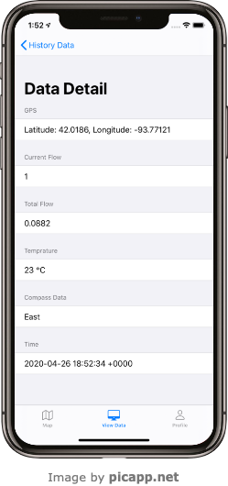
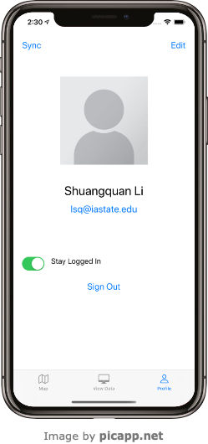
Runtime User Interface Diagram
Shuangquan

Slide 12
Detailed Design - API
Emphasis on intuitive APIs
Clean, Simple Database design
Simple two-way API calls
Technologies Used:
Firebase API
Mapbox SDK
Swift
Sean

Slide 13
Detailed Design - Hardware
Emphasis on PCB Design
Technologies Used
Arduino
ArduinoJSON
TinyGPS++
SoftwareSerial
CircuitMaker
Kevin

Slide 14
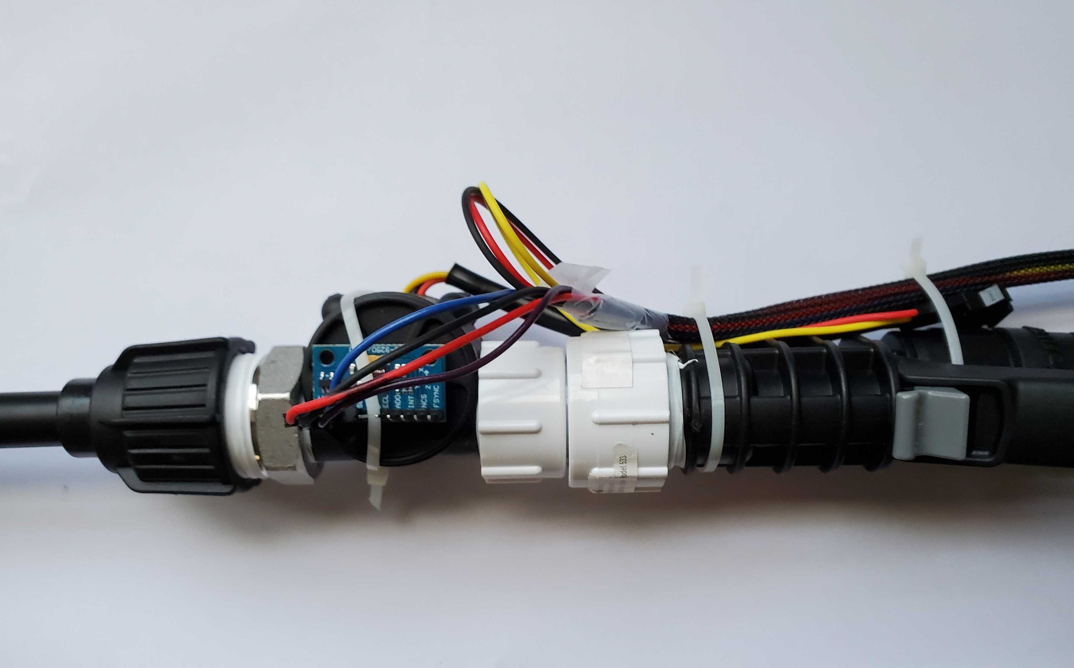
Detailed Design
Hardware
Image Key
Blue - Flow Sensor
Red - Compass/Accelerometer
David

Slide 15
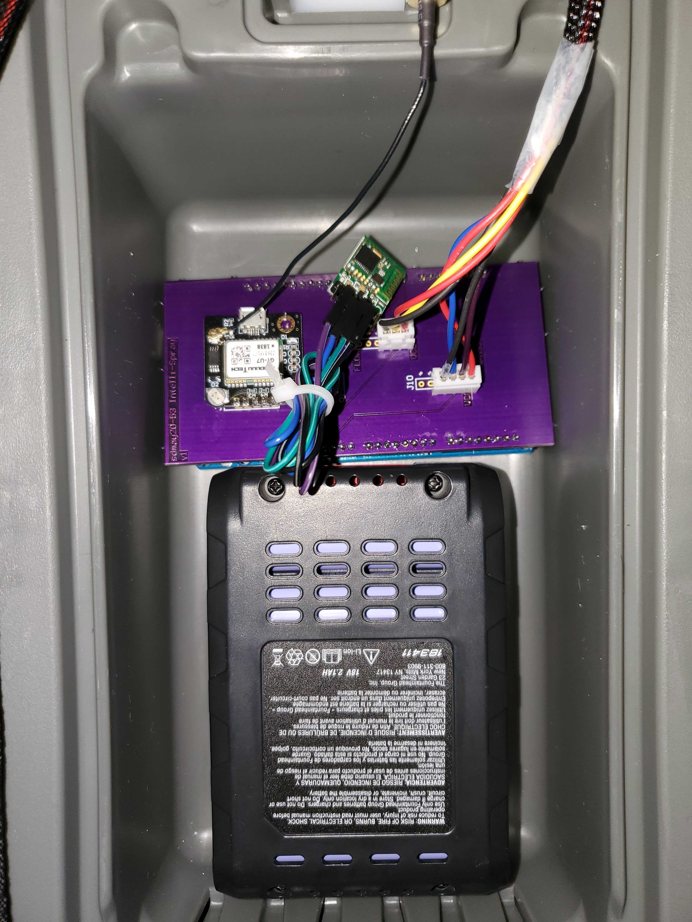
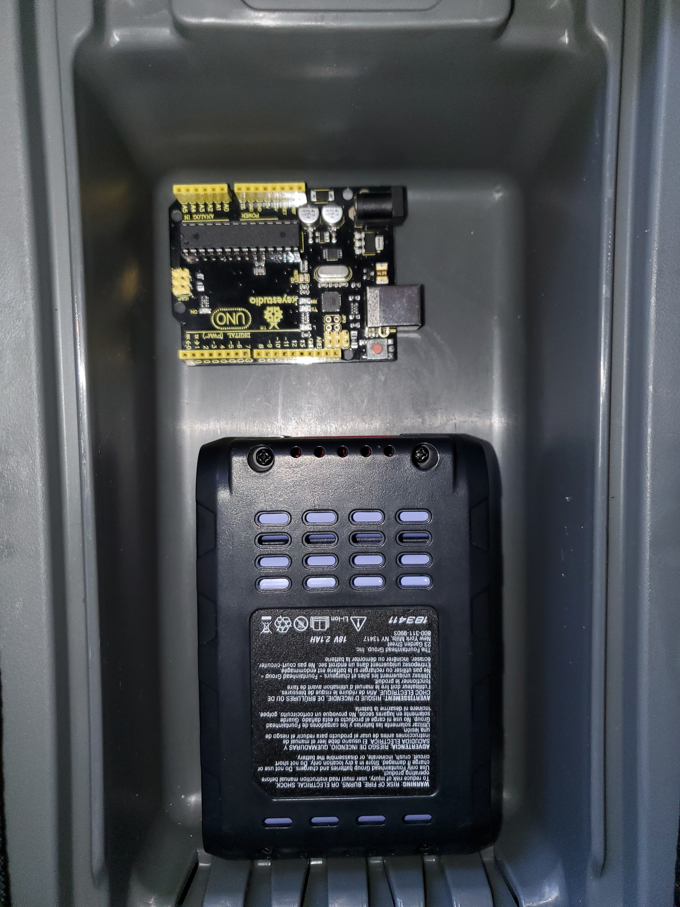
Detailed Design
Hardware
Arduino UNO R3
GPS Module
Flow and Compass Module
Arduino Mega 2560
BLE Module
David

Slide 16
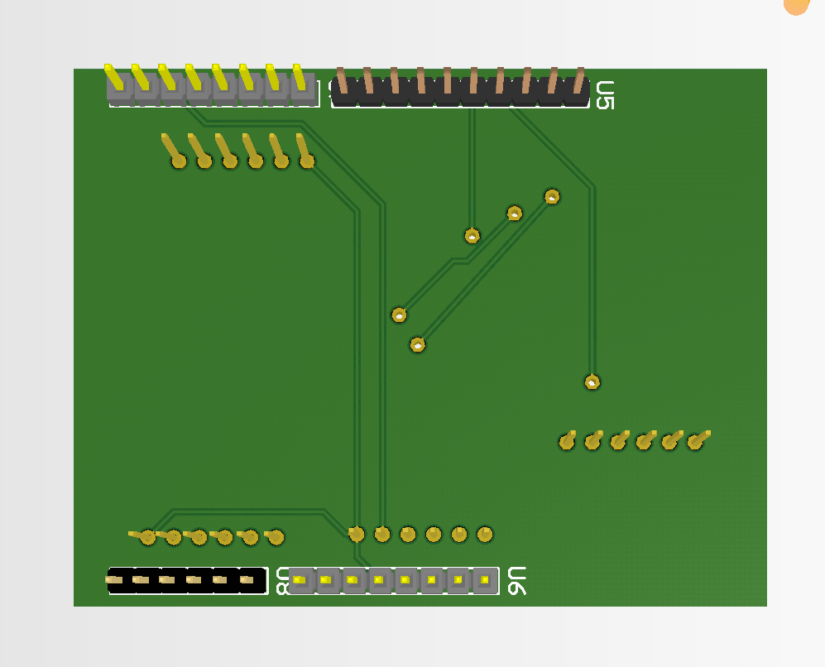
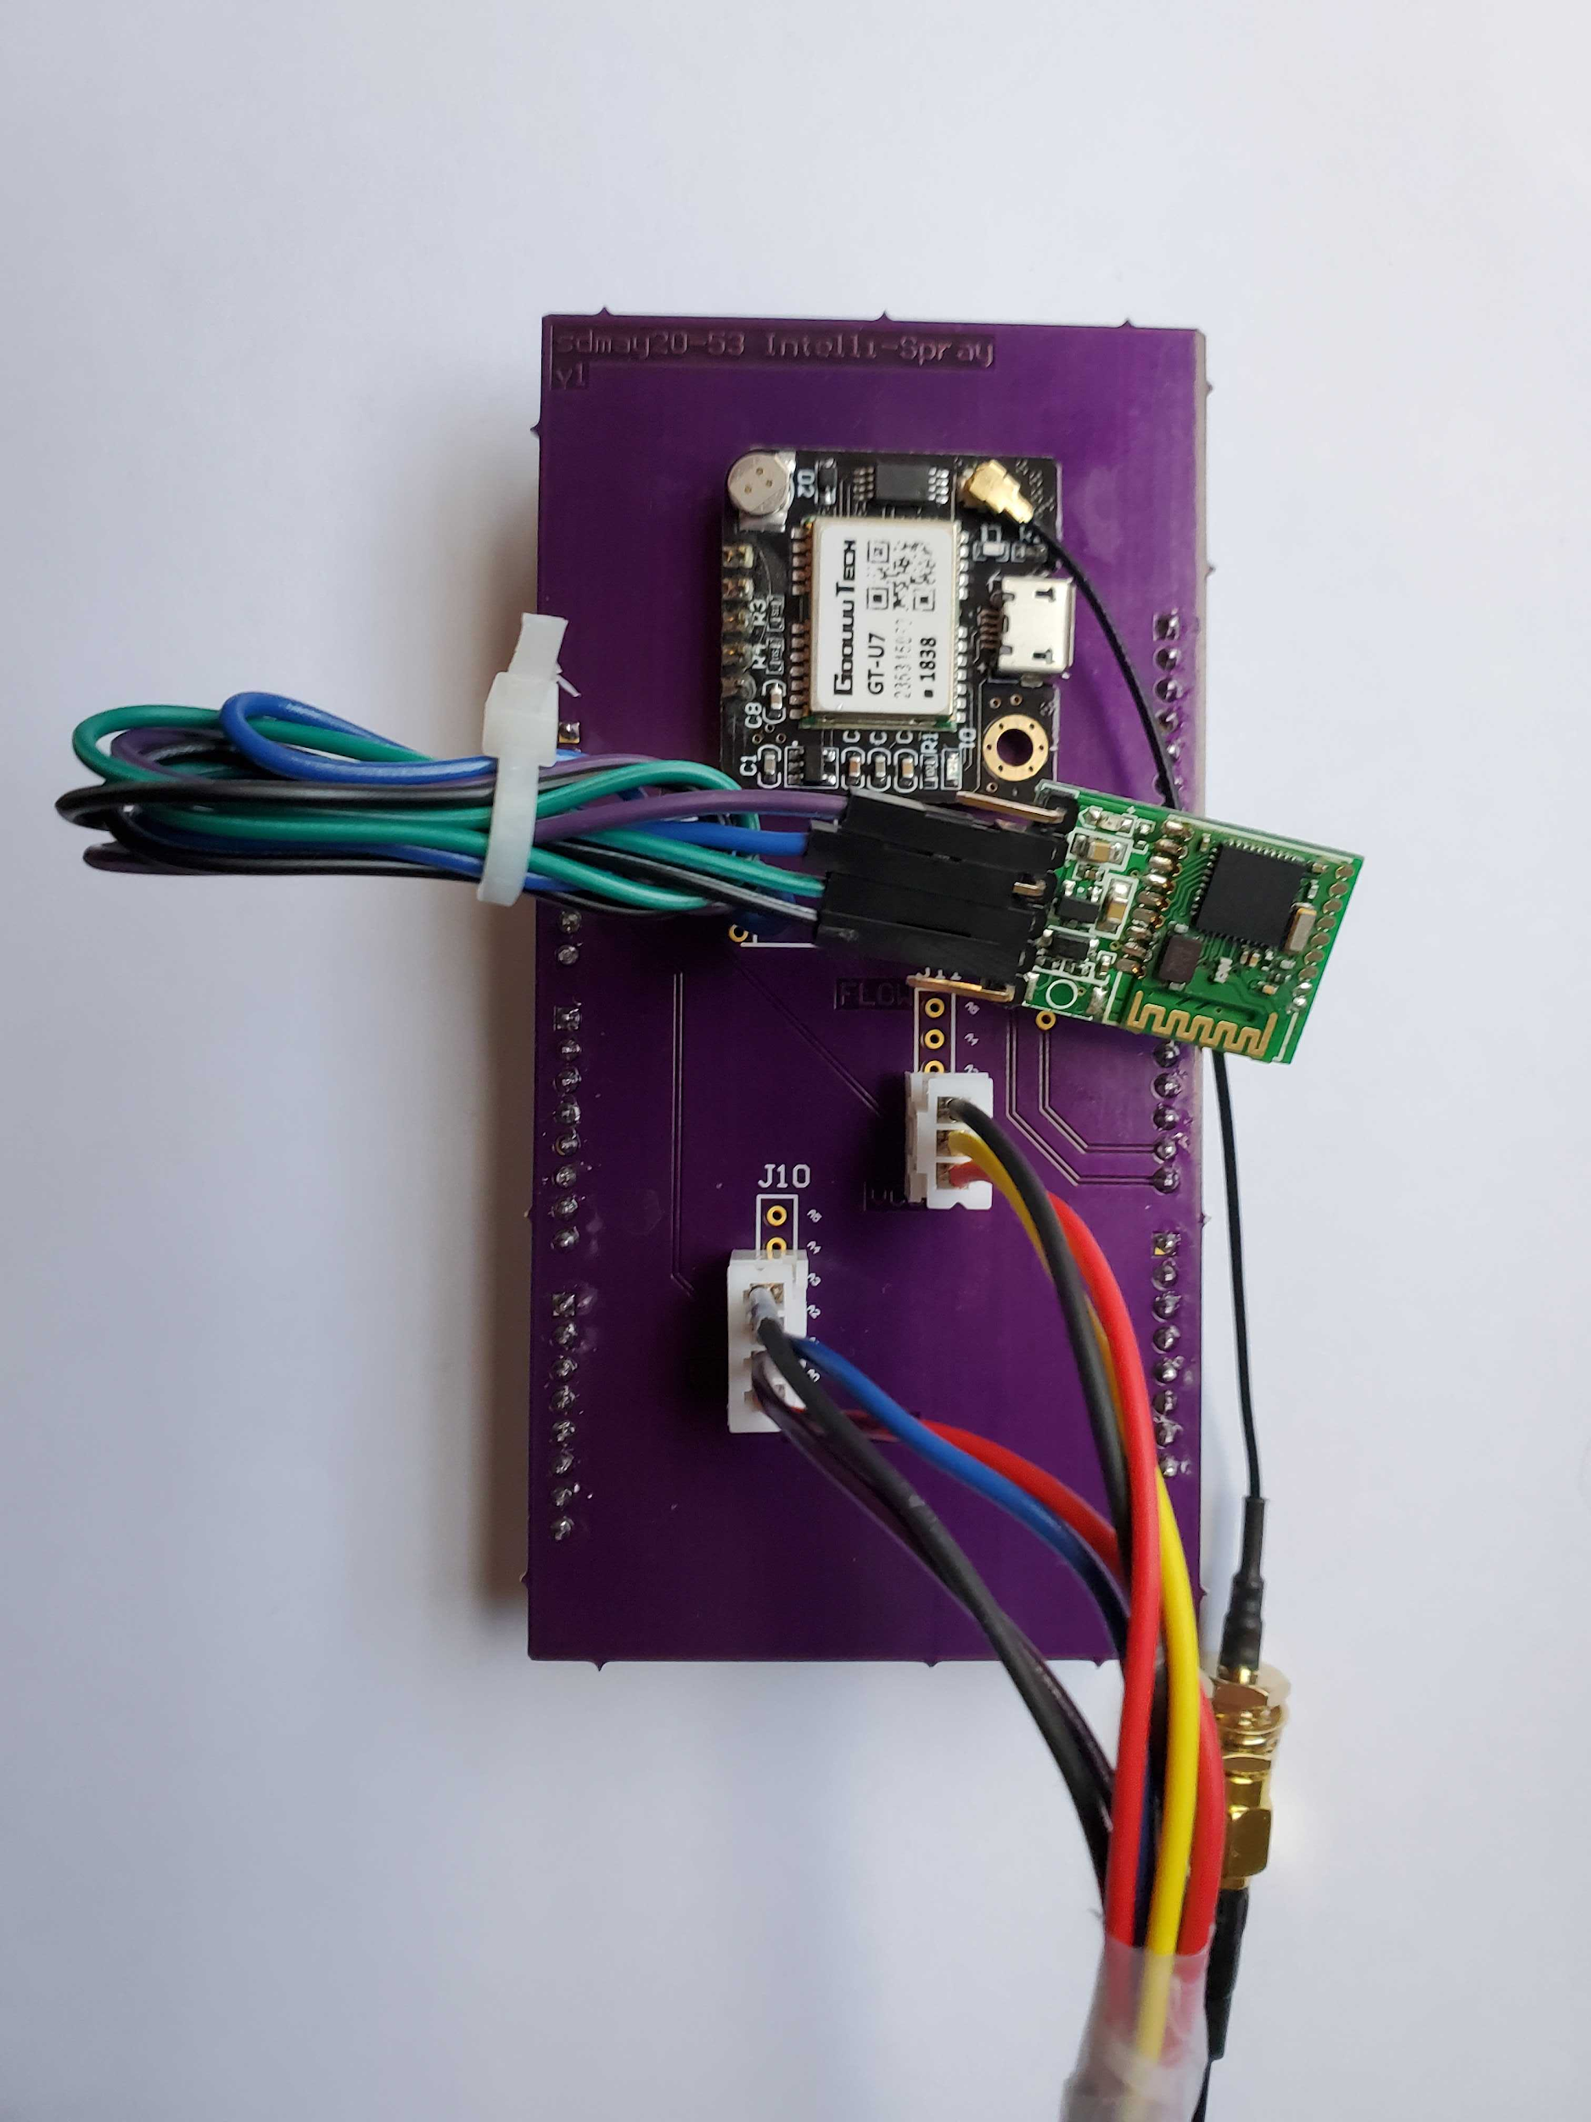
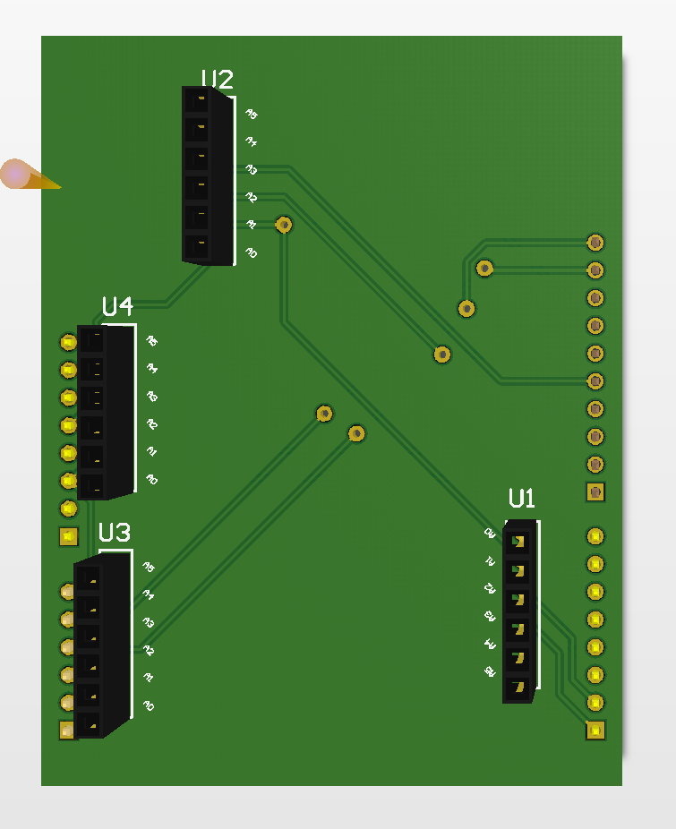
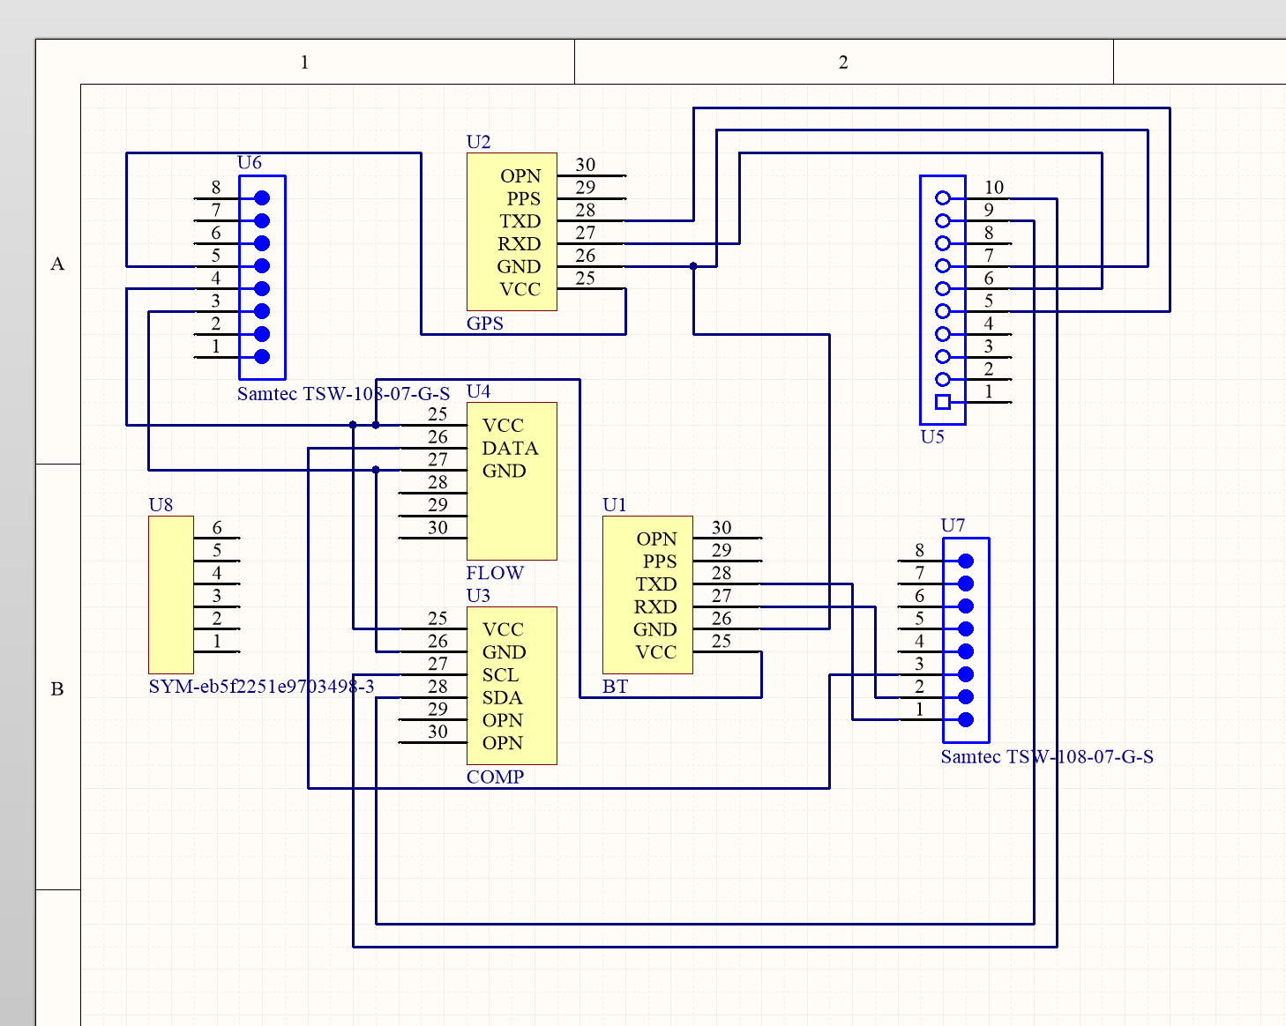
Detailed Design
Hardware
Arduino UNO Version
Arduino Mega 2560 Version
Kevin

Slide 17
Demo
Shuangquan

Slide 18
Test Plan
How is testing performed?
Simulator - iOS 13
Real device - iPhones
Component/Unit testing
Testing each methods
Testing the modules of the hardware - flow sensors, GPS sensors
Interface/integration testing
Testing where top-level units are tested first and lower level units are tested step by step after that
Acceptance testing
Testing all the listed requirement in the design document.
Donald
Notes:
Donald

Slide 19
Test Results
Hardware
GPS module tested individually - Successful
Bluetooth module tested individually - Successful
Flow sensor tested individually - Successful
Compass sensor tested individually - Successful
Integration of parts with backpack - Successful
Software
Login on app - Successful
Received data through bluetooth - Successful
Map plotting and storing mock data - Partially Successful
Map plotting and storing real data - Incomplete
David
Notes:
David

Slide 20
Engineering Standards and Design Practices
Software Development
ISO/IEC 12207
Stakeholder needs and requirements
Systems/Software requirements
Integration
Etc
Digital Design
IEEE 1016
Data, Architecture, Interface, and Procedural Design
Kevin

Slide 21
Future Work
Analyze spray patterns to better plot them on a map
Try a different communication method
WiFi
Try a different controller
ESP32 - Dual core processor
Additional/Integration Testing
Future development utilizing gyroscope data
Other use cases
Proof of application
Drone application
Sean
Notes:
Shuangquan and kev

Slide 22
What we learned/would change?
Lessons learned
Develop to client requirements/project
Communicate openly with client and advisor throughout project
Changes
More smaller deadlines
Collect more test data
Implement all of user interface in SwiftUI
Use WiFi instead of Bluetooth
Integrate earlier
Have a proper managed git repository
Madison

Slide 23
Conclusion
Summary
Built an application and hardware that connect to a backpack sprayer allowing for data collection
Issues encountered
Unable to get to field testing & client feedback
Implementation and integration logistical roadblocks
Project Status
Rough Prototype created
Components are created
Testing in progress
Donald
Notes:
Don

Slide 24
Market Research
Other Smart Backpack Sprayers:
AgTerra
Tracks location of user
Tracks what chemical has been sprayed
Android only
Ours:
Tracks location of user
Tracks what chemical has been sprayed
Tracks where has been sprayed - Coverage
iOS only
David
Notes:
David

