Slide 1
SDMAY20-53:
Smart Backpack Sprayer
David Hayes (Communication Guru)
Madison Kriege (Meeting Scribe)
Kevin Davis (Hardware Research Lead)
Sean Doran (Logistics Master)
Donald Laraquente (API Research Lead)
Shangquan Li (iOS Expert)
Clients: Tim Andersen & Taylor Greiner
Advisor: Dr. Daji Qiao
Notes:
David

Slide 2
Project Vision
Create a smart backpack sprayer for different uses
Small scale agricultural operations
City use for spraying sidewalks or parks
Display data to user
Increase efficiency of spraying
Record of previous applications
Impacts to User
Minimize excess spraying
Minimize spraying costs
Ensure full coverage of spray on land
Notes:
David

Slide 3
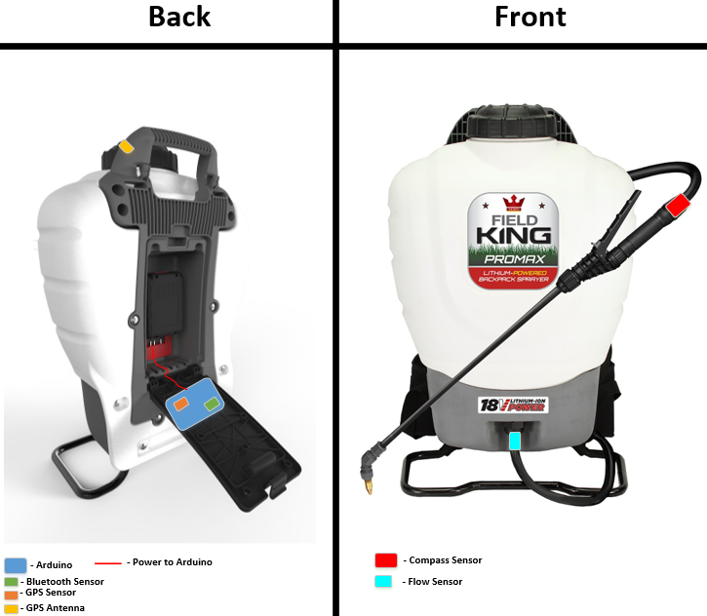
Conceptual Sketch
Application that interfaces with backpack sprayer
Clientele are farmers and city employees
Unique in that project adapts existing hardware to fit requirements
Notes:
David

Slide 4
Hardware Functional Reqs
The hardware shall
Use a flow sensor with accuracy to 10% of the duty cycle
Use a GPS sensor with accuracy to 3 meters
Use a compass Sensor with accuracy to 30 degrees
The hardware shall have a battery life at least 3 hours.
The hardware shall be mountable inside backpack sprayer
The hardware shall package data in JSON format
The hardware shall be able to send data using Bluetooth
Data shall be collected in 1 second intervals
Data collection shall be time-stamped with 24 hour time format
Notes:
Kevin

Slide 5
Non-Functional Reqs (Hardware)
The system shall be waterproof
The system shall be operable in temperatures between 0-40C
The system shall be under 30 pounds
The system shall be wearable on one's back
Notes:
Kevin

Slide 6
Functional Reqs (Software)
The app shall display the row data
The app shall display data in the map with a pin
The app shall support multi-user usability
The app shall support editing the type of chemicals
The app shall sync data between cloud and local
The app shall support offline data access
Notes:
Sean

Slide 7
Non-Functional Reqs (Software)
The code base shall easy to maintain
Data shall only accessible to authorized user
The system shall support large amount data transmission
Notes:
Sean

Slide 8
Technical and Other Constraints
Mobile platform - iOS
Data format - JSON
Close range communication - Bluetooth
Low/off network connectability
Notes:
Shuangquan

Slide 9
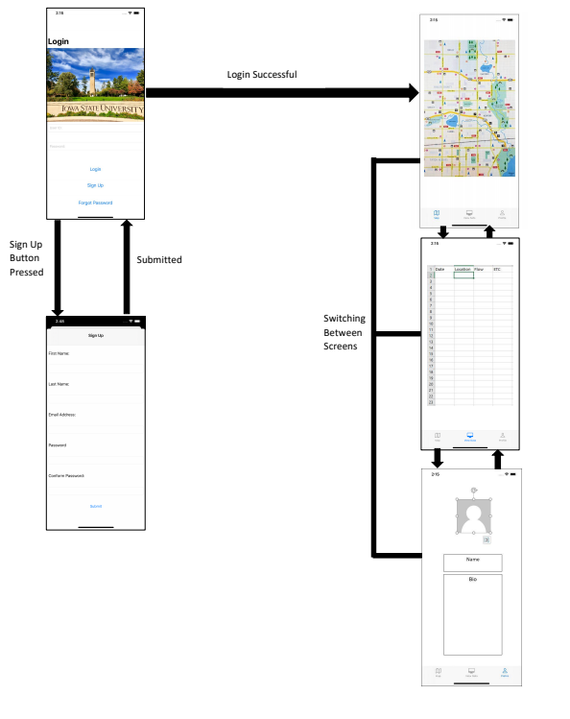
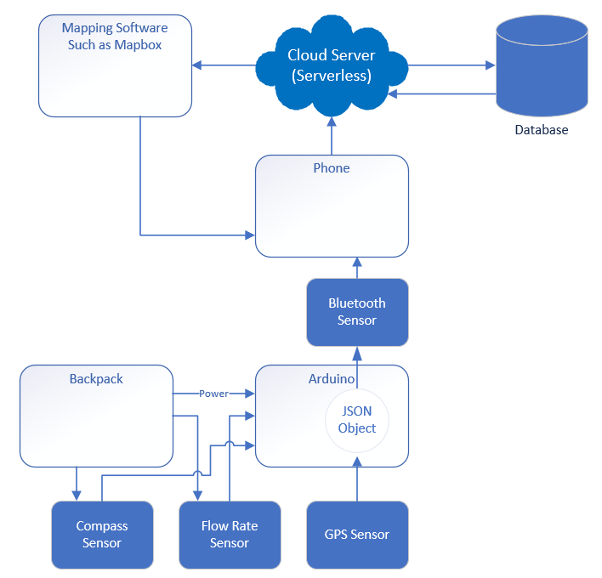
Conceptual Design Diagram
Notes:
Don

Slide 10
Project Plan
Project Tasks
3 sub-teams, each focused on one component
Hardware: David and Kevin
iOS Application: Madison and Shangquan
API Integration: Sean and Donald
Risk Management
Accuracy of sensors
Mitigation: Purchasing new hardware
Compatibility of sub-components
Mitigation: Early and often integration
Notes:
Maddy

Slide 11
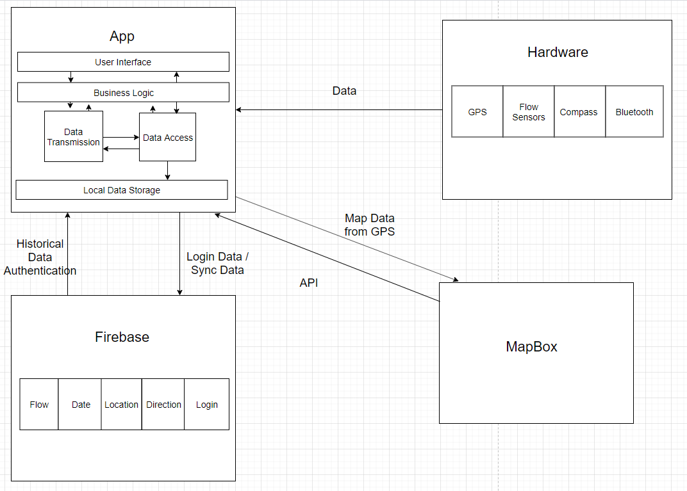
Detailed Design - System Architecture Diagram
Notes:
Shuangquan

Slide 12
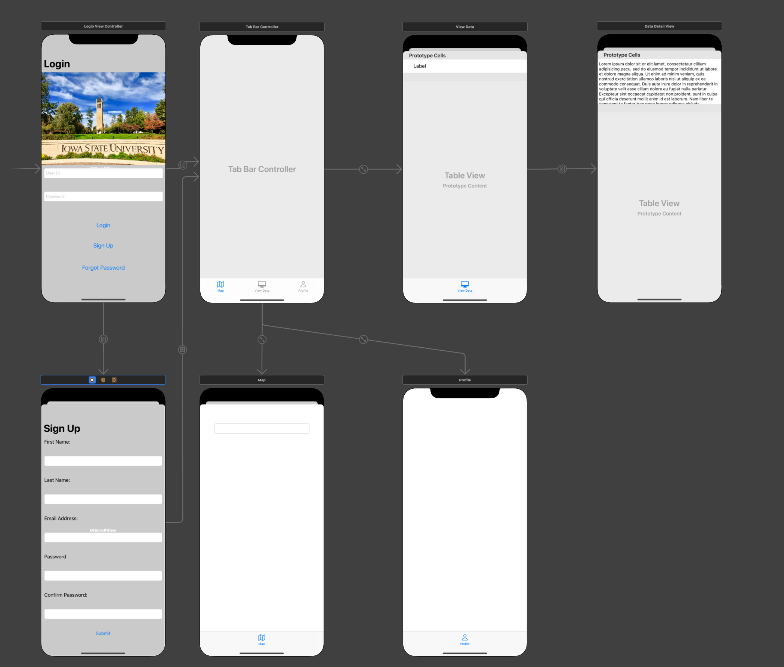
Detailed Design
Interface Diagram
Notes:
Shuangquan

Slide 13
HW/SW Platforms
Hardware Platforms
Arduino
TinyGPS++
ArduinoJSON
Software Platforms
Firebase
Xcode
iOS
Mapbox
C++
Notes:
Madison

Slide 14
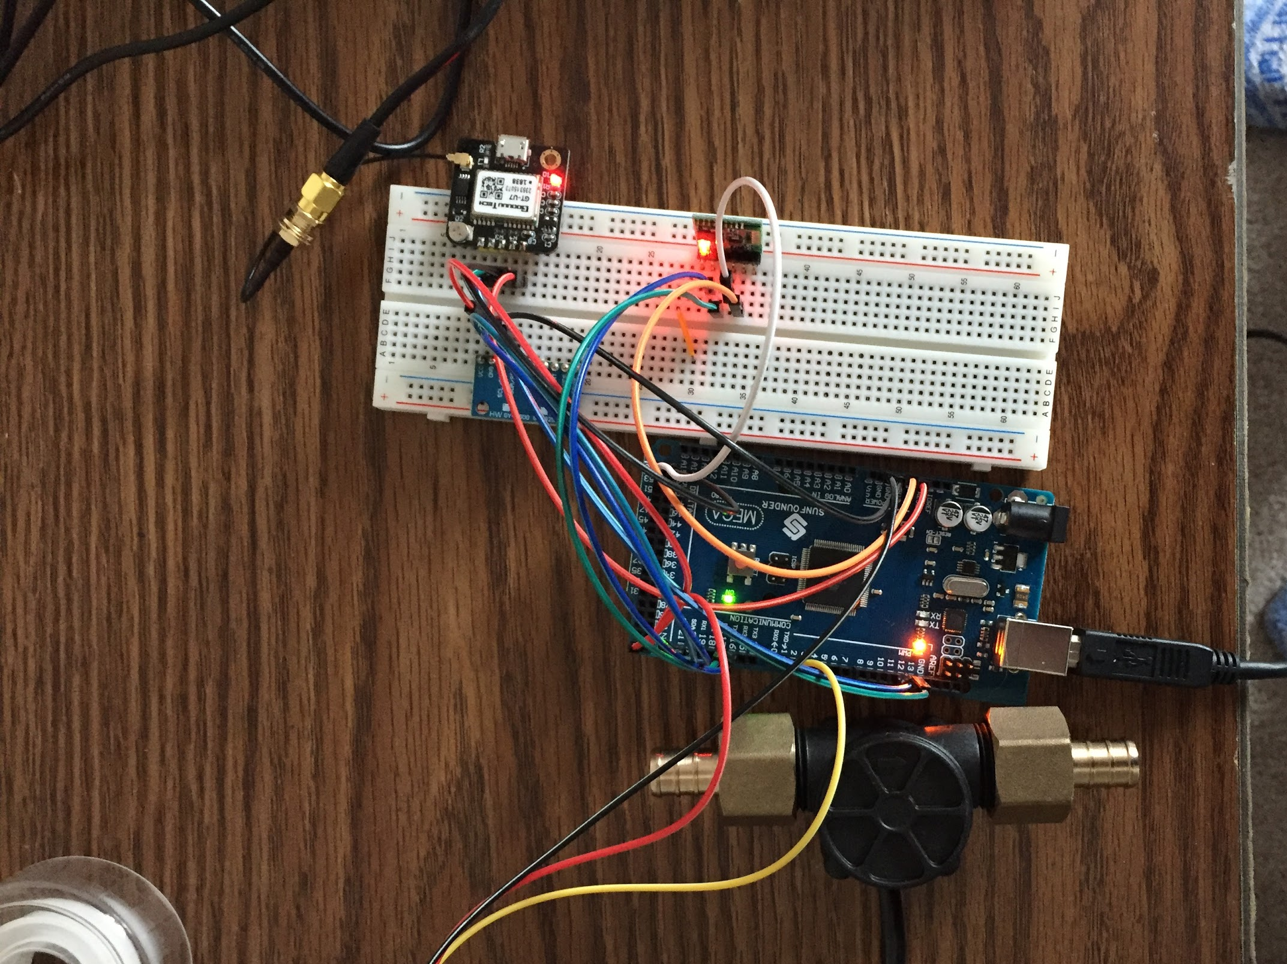
Prototype Implementations - Hardware
Test hardware sensors individually
Integrate together in single program
Results
Collecting more data to ensure they are accurate
Bluetooth - work in progress
Package data to be sent
Notes:
Kevin

Slide 15
Prototype Implementations - iOS
An app has been implemented
Results
Displays raw data
Has multi-user login
Displays the map with current location
Connects to the cloud and transmit data
Notes:
Madison

Slide 16
Prototype Implementations - API
Any prototype implementations?
We have created a simple project in Firebase
This project allows us to use authentication and database services
We have created a simple project in Mapbox
This allows us to show the points we plot from the data received
The firebase authentication and database work as intended
Users can create new accounts using their email and a password
Users can login using their created information
Users can also use their email to reset their password
Notes:
Sean

Slide 17
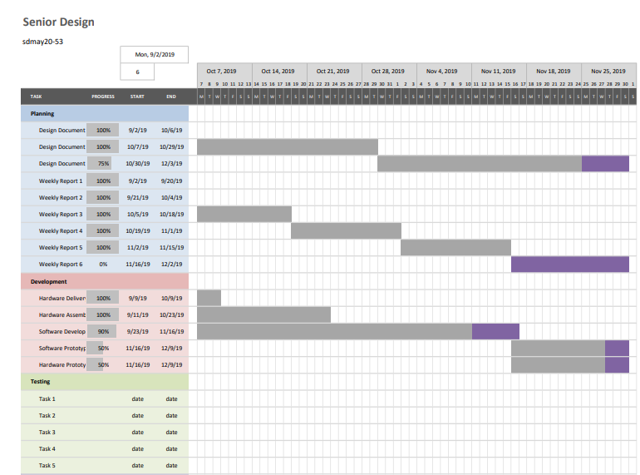
Gantt Chart

Slide 18
Project Plan – Schedule
Notes:
Don

Slide 19
Project Plan – Milestones
Hardware Delivery - Oct 9, 2019
Assembling Hardware - Oct 23, 2019
Software Completion - Nov 16, 2019
Integration - Dec 2, 2019
Prototype for Software and Hardware - Due Dec 09, 2019
Notes:
Don

Slide 20
Test Plan
How is testing performed?
Simulator - iOS 13
Real device - iPhones
Component/Unit testing
Testing each methods
Testing the modules of the hardware - flow sensors, GPS sensors
Interface/integration testing
Testing where top-level units are tested first and lower level units are tested step by step after that
Acceptance testing
Testing all the listed requirement in the design document.
Notes:
Shuangquan and kev

Slide 21
Conclusion
Where are you in your schedule?
On track
We have completed enough of the basic design and documentation to allow the team to focus on software and hardware implementation
Next semester’s plans
Continue working on software and hardware design.
Complete several implementations related to bluetooth and sending information.
In addition, we plan to
Individual team members contributions
Notes:
Maddie

Slide 22
Questions?
Notes:
Maddy

